Slide 1
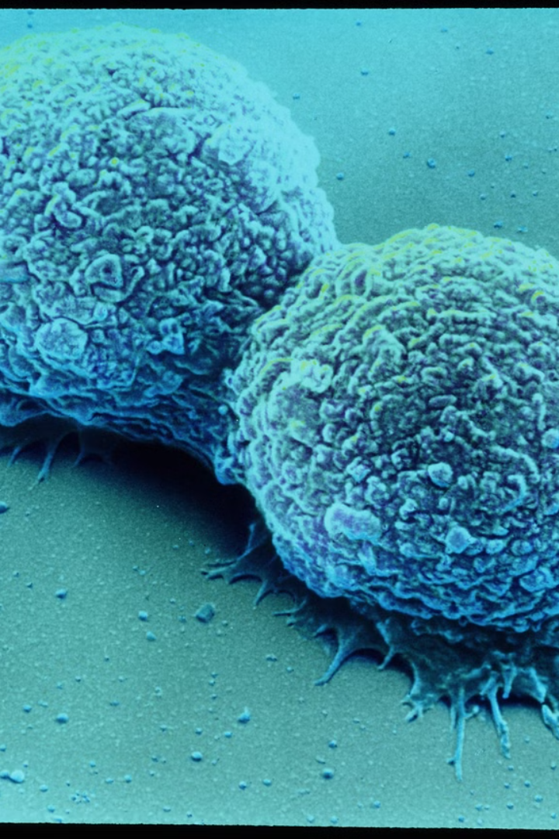
Breast Cancer Image Classification
-Jay Gondalia

Slide 2
Introduction
Breast cancer is a prevalent health concern globally, with early and accurate diagnosis crucial for effective treatment. Deep learning techniques offer significant potential for improving breast cancer image classification. This report describes the development and evaluation of a deep learning model for this purpose.

Slide 3


Dataset Description
1
4000 Images
2
Two Classes
The project utilizes a breast cancer dataset containing 4000 images from various sources.
The dataset is divided into two classes: negative (benign) and positive (malignant), each containing 2000 images.
3
Importance of Balance
A balanced dataset is crucial for training effective classification models.

Slide 4
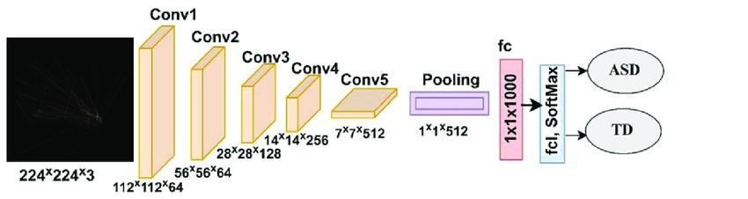
Model Architecture
Pre-Trained ResNet-18
Customized Layer
Performance Enhancement
A pre-trained ResNet-18 convolutional neural network (CNN) serves as the foundation of the model.
The final fully connected layer of the pre-trained model is replaced with a new layer designed for binary classification (benign or malignant).
Pre-trained models leverage knowledge gained from solving similar tasks, accelerating learning and improving performance.

Slide 5

Training Process
Data Pre-Processing
Model Base
Optimization
The training method involves loading and pre-processing the breast cancer dataset (resizing, normalization).
A pre-trained ResNet-18 CNN serves as the base, with the last fully connected layer substituted for binary classification.
The cross-entropy loss function calculates prediction errors, and the SGD optimizer modifies model parameters.

Slide 6
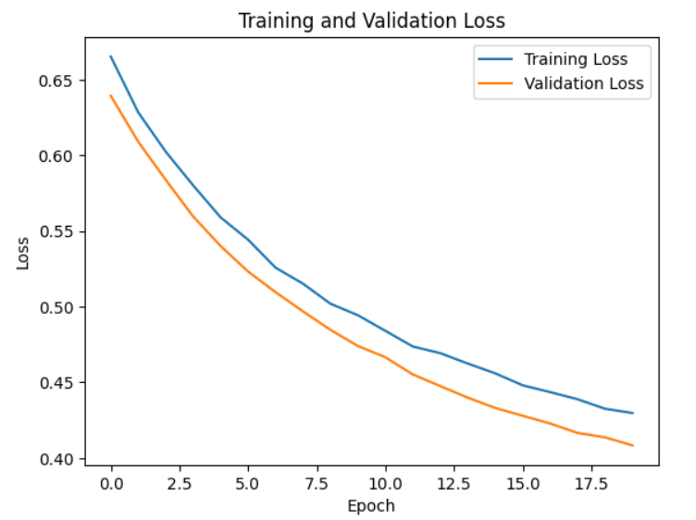
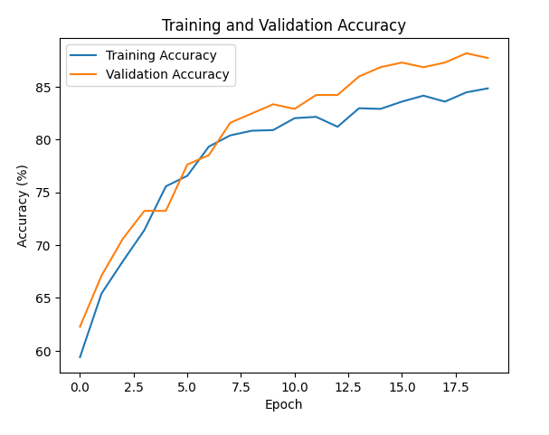
Evaluation Results
1
Training Loss
After 20 epochs of training, the model achieved a training loss of 0.430 and a training accuracy of 84.837%.
2
Validation Loss
Validation loss was 0.408, and validation accuracy was 87.719%.
3
Additional Metrics
Additional metrics like precision, recall, and F1 score can be calculated to provide a more comprehensive understanding of the model's performance.

Slide 7
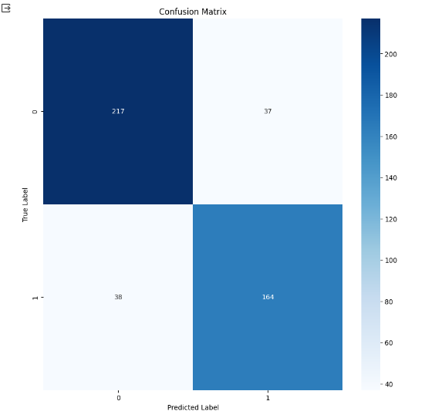
Confusion Matrix

Slide 8


Conclusion
Accurate Categorization
Opportunities for Improvement
The project has successfully developed a breast cancer image classification model capable of accurately categorizing images as benign or malignant.
While achieving promising results, there are opportunities for improvement, including fine-tuning the model architecture and exploring additional data augmentation techniques to enhance performance further.

Slide 9
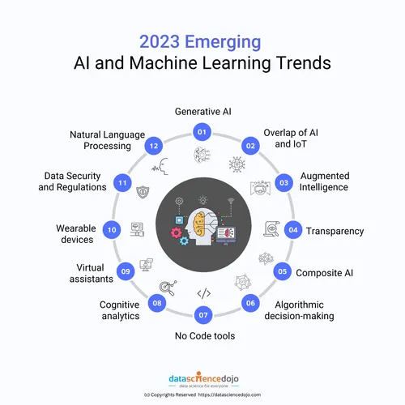
Future Considerations
1
Larger Dataset Testing
2
Ethical Considerations
Further work should involve testing the model on a larger, independent dataset to ensure generalizability and robustness.
Ethical considerations, such as potential biases in the training data and the need for human supervision, require careful attention in real-world applications.
3
Regulatory Aspects
Regulatory aspects of deploying such models in clinical settings need to be addressed.

Slide 10

Global Impact
Patient Care Improvement
By continuing to develop and refine this model, it has the potential to become a valuable tool for breast cancer diagnosis, ultimately contributing to improved patient care.

Slide 11


